Slide 1
TCP congestion control: AIMD
approach: senders can increase sending rate until packet loss (congestion) occurs, then decrease sending rate on loss event
Additive Increase
Multiplicative Decrease
increase sending rate by 1 maximum segment size every RTT until loss detected
cut sending rate in half at each loss event
AIMD sawtooth
behavior: probing
for bandwidth
TCP sender Sending rate
time

Slide 2
TCP AIMD: more
Multiplicative decrease detail: sending rate is
Cut in half on loss detected by triple duplicate ACK (TCP Reno)
Cut to 1 MSS (maximum segment size) when loss detected by timeout (TCP Tahoe)
Why AIMD?
AIMD – a distributed, asynchronous algorithm – has been shown to:
  optimize congested flow rates network wide!
  have desirable stability properties

Slide 3

TCP slow start
Host A
Host B
when connection begins, increase rate exponentially until first loss event:
  initially cwnd = 1 MSS
  double cwnd every RTT
  done by incrementing cwnd for every ACK received
one segment
RTT
two segments
four segments
summary: initial rate is slow, but ramps up exponentially fast
time

Slide 4
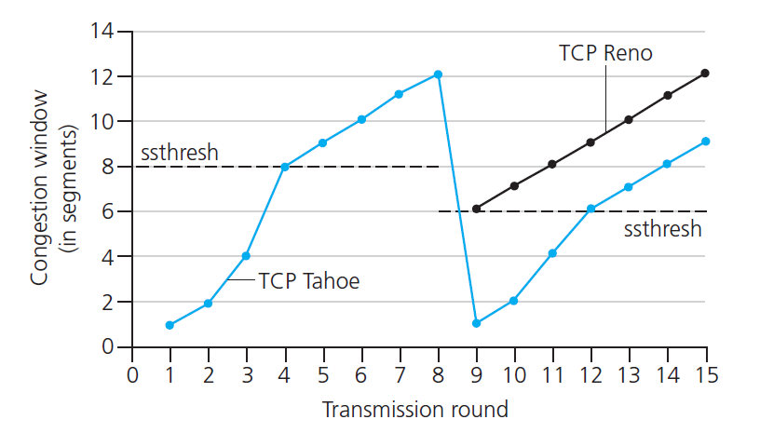

TCP: from slow start to congestion avoidance
Q: when should the exponential increase switch to linear?
A: when cwnd gets to 1/2 of its value before timeout.
X
Implementation:
variable ssthresh
on loss event, ssthresh is set to 1/2 of cwnd just before loss event

Slide 5
TCP fairness
Fairness goal: if K TCP sessions share same bottleneck link of bandwidth R, each should have average rate of R/K
TCP connection 1
bottleneck
router
capacity R
TCP connection 2

Slide 6
Q: is TCP Fair?
Example: two competing TCP sessions:
additive increase gives slope of 1, as throughout increases
multiplicative decrease decreases throughput proportionally
R
equal bandwidth share
Is TCP fair?
A: Yes, under idealized assumptions:
same RTT
fixed number of sessions only in congestion avoidance
loss: decrease window by factor of 2
congestion avoidance: additive increase
Connection 2 throughput
loss: decrease window by factor of 2
congestion avoidance: additive increase
Connection 1 throughput
R

Slide 7
Fairness: must all network apps be “fair”?
Fairness and UDP
multimedia apps often do not use TCP
  do not want rate throttled by congestion control
instead use UDP:
  send audio/video at constant rate, tolerate packet loss
there is no “Internet police” policing use of congestion control
Fairness, parallel TCP connections
application can open multiple parallel connections between two hosts
web browsers do this , e.g., link of rate R with 9 existing connections:
  new app asks for 1 TCP, gets rate R/10
  new app asks for 11 TCPs, gets R/2

Slide 8
IP addressing: introduction
223.1.1.1
IP address: 32-bit identifier associated with each host or router interface
interface: connection between host/router and physical link
  router’s typically have multiple interfaces
  host typically has one or two interfaces (e.g., wired Ethernet, wireless 802.11)
223.1.2.1
223.1.1.2
223.1.1.4
223.1.2.9
223.1.1.3
223.1.3.27
223.1.2.2
223.1.3.1
223.1.3.2
dotted-decimal IP address notation:
223.1.1.1 = 11011111 00000001 00000001 00000001
223
1
1
1

Slide 9
Subnets
223.1.1.1
What’s a subnet ?
  device interfaces that can physically reach each other without passing through an intervening router
223.1.2.1
223.1.1.2
223.1.1.4
223.1.2.9
223.1.1.3
223.1.3.27
223.1.2.2
IP addresses have structure:
  subnet part: devices in same subnet have common high order bits
  host part: remaining low order bits
223.1.3.1
223.1.3.2
network consisting of 3 subnets

Slide 10
Subnets
subnet 223.1.1.0/24
223.1.1.1
subnet 223.1.2.0/24
Recipe for defining subnets:
detach each interface from its host or router, creating “islands” of isolated networks
each isolated network is called a subnet
223.1.2.1
223.1.1.2
223.1.1.4
223.1.2.9
223.1.1.3
223.1.3.27
223.1.2.2
subnet
223.1.3.0/24
223.1.3.1
223.1.3.2
subnet mask: /24
(high-order 24 bits: subnet part of IP address)

Slide 11
Subnets
223.1.1.2
subnet 223.1.1/24
where are the subnets?
what are the /24 subnet addresses?
223.1.1.1
223.1.1.4
223.1.1.3
223.1.9.2
223.1.7.0
subnet 223.1.7/24
subnet 223.1.9/24
223.1.9.1
223.1.7.1
223.1.8.1
223.1.8.0
subnet 223.1.2/24
223.1.2.6
subnet 223.1.8/24
223.1.3.27
subnet 223.1.3/24
223.1.2.1
223.1.2.2
223.1.3.1
223.1.3.2

Slide 12
CIDR: Classless Inter Domain Routing
(pronounced “cider”)
CIDR tries to balance the desire to minimize the number of routes that a router needs to know against the need to hand out addresses efficiently.
CIDR uses aggregate routes
  Uses a single entry in the forwarding table to tell the router how to reach a lot of different networks
  Breaks the rigid boundaries between address classes

Slide 13
CIDR: Classless Inter Domain Routing
Consider an organization with 16 class C network numbers.
Instead of handing out 16 addresses at random, hand out a block of contiguous class C addresses
Suppose we assign the class C network numbers from 192.4.16 through 192.4.31
Observe that top 20 bits of all the addresses in this range are the same (11000000 00000100 0001)
  We have created a 20-bit network number (which is in between class B network number and class C number)
Requires to hand out blocks of class C addresses that share a common prefix

Slide 14
CIDR: Classless Inter Domain Routing
The convention is to place a /x after the prefix where x is the prefix length in bits
  The 20-bit prefix for all the networks 192.4.16 through 192.4.31 is represented as 192.4.16/20
By contrast, if we wanted to represent a single class C network number, which is 24 bits long, we would write it 192.4.16/24
Common prefix
host
part
192.4.16
11000000 00000100 00010000 00000000
Common prefix
host
part
192.4.31
11000000 00000100 00011111 00000000

Slide 15
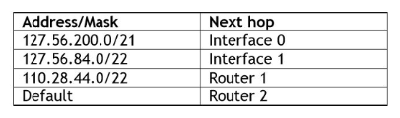
CIDR: Classless Inter Domain Routing
How do the routing protocols handle this classless addresses
  It must understand that the network number may be of any length
All routers must understand CIDR addressing
192.4.16.0/20
Interface 3

Slide 16
Hierarchical addressing: route aggregation
hierarchical addressing allows efficient advertisement of routing information:
Organization 0
200.23.16.0/23
Organization 1
200.23.18.0/23
“Send me anything
with addresses
beginning
200.23.16.0/20”
Organization 2
200.23.20.0/23
.
Fly-By-Night-ISP
.
.
.
.
Internet
Organization 7
.
200.23.30.0/23
ISPs-R-Us
“Send me anything
with addresses
beginning
199.31.0.0/16”

Slide 17
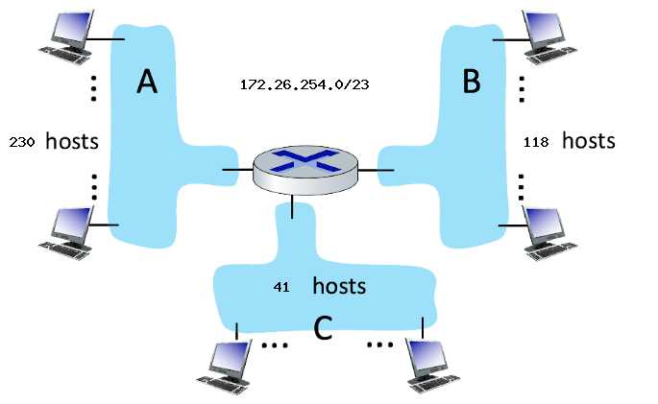
SUBNET ADDRESSING
Assign subnet addresses to each of the subnets (A, B, C) so that the amount of address space assigned is minimal, and at the same time leaving the largest possible contiguous address space available for assignment if a new subnet were to be added.

Slide 18
SUBNET ADDRESSING
How many hosts can there be in this address space?

Slide 19
SUBNET ADDRESSING
What is the subnet address of subnet A? (CIDR notation)

Slide 20
SUBNET ADDRESSING
What is the broadcast address of subnet A?

Slide 21
SUBNET ADDRESSING
What is the starting address of subnet A?

Slide 22
SUBNET ADDRESSING
What is the ending address of subnet A?

Slide 23
IPv6: motivation
initial motivation: 32-bit IPv4 address space would be completely allocated
additional motivation:
  speed processing/forwarding: 40-byte fixed length header
  enable different network-layer treatment of “flows”

Slide 24
IPv6 datagram format
flow label: identify datagrams in same "flow.” (concept of “flow” not well defined).
32 bits
priority: identify priority among datagrams in flow
ver
pri
flow label
payload len
next hdr
hop limit
source address
(128 bits)
128-bit
IPv6 addresses
destination address
(128 bits)
payload (data)
What’s missing (compared with IPv4):
no checksum (to speed processing at routers)
no fragmentation/reassembly
no options (available as upper-layer, next-header protocol at router)

Slide 25
Transition from IPv4 to IPv6
not all routers can be upgraded simultaneously
  no “flag days”
  how will network operate with mixed IPv4 and IPv6 routers?
tunneling: IPv6 datagram carried as payload in IPv4 datagram among IPv4 routers (“packet within a packet”)
  tunneling used extensively in other contexts (4G/5G)
IPv4 header fields
IPv6 header fields
IPv4 payload
IPv4 source, dest addr
IPv6 source dest addr
UDP/TCP payload
IPv6 datagram
IPv4 datagram

Slide 26
Tunneling
A
B
IPv4 tunnel
connecting IPv6 routers
E
F
logical view:
IPv6
IPv6/v4
IPv6/v4
IPv6
A
B
C
D
E
F
physical view:
IPv6
IPv6/v4
IPv4
IPv4
IPv6/v4
IPv6
flow: X
src: A
dest: F
data
src:B
dest: E
src:B
dest: E
src:B
dest: E
flow: X
src: A
dest: F
data
Flow: X
Src: A
Dest: F
data
Flow: X
Src: A
Dest: F
data
Flow: X
Src: A
Dest: F
data
Note source and destination addresses!
A-to-B:
IPv6
B-to-C:
IPv6 inside
IPv4
C-to-D:
IPv6 inside
IPv4
D-to-E:
IPv6 inside
IPv4
E-to-F:
IPv6

Slide 27
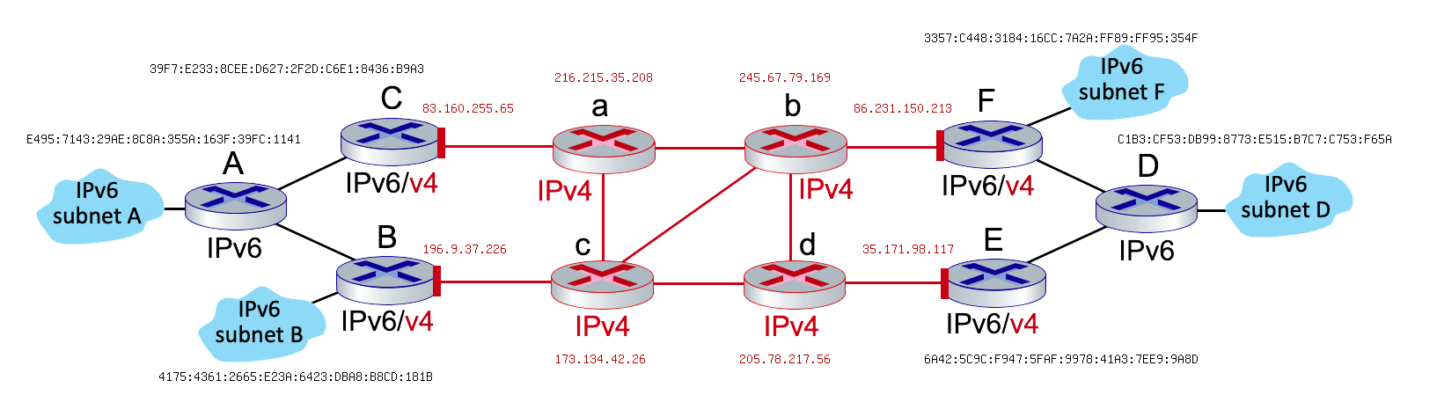
IPV6 TUNNELING AND ENCAPSULATION
Suppose that a host of subnet D wants to send an IPv6 datagram to a host on subnet B.
Assume that the forwarding between these two hosts goes along the path: D --> F --> b --> d --> c --> B
What is the source address of this F to b datagram?
What is the destination address of this F to b datagram??

Slide 28
IPV6 TUNNELING AND ENCAPSULATION
3. What is the source address of this encapsulated datagram in this F to b datagram?
4. What is the destination address of this encapsulated datagram in this F to b datagram?

Slide 29

Network layer: “control plane” roadmap
introduction
routing protocols
  link state
  distance vector
intra-ISP routing: OSPF
routing among ISPs: BGP
SDN control plane
Internet Control Message Protocol

Slide 30
Graph abstraction: link costs
5
c_{a,b}: cost of direct link connecting a and b
e.g., c_{w,z} = 5, c_{u,z} = ∞
cost defined by network operator: could always be 1, or inversely related to bandwidth, or inversely related to congestion
v
3
w
2
5
u
2
1
z
3
1
2
x
y
1
graph: G = (N,E)
N: set of routers = { u, v, w, x, y, z }
E: set of links ={ (u,v), (u,x), (v,x), (v,w), (x,w), (x,y), (w,y), (w,z), (y,z) }

Slide 31
Dijkstra’s link-state routing algorithm
centralized: network topology, link costs known to all nodes
  accomplished via “link state broadcast”
  all nodes have same info
computes least cost paths from one node (“source”) to all other nodes
  gives forwarding table for that node
iterative: after k iterations, know least cost path to k destinations
notation
c_{x,y}: direct link cost from node x to y; = ∞ if not direct neighbors
D(v): current estimate of cost of least-cost-path from source to destination v
p(v): predecessor node along path from source to v
N': set of nodes whose least-cost-path definitively known

Slide 32
Dijkstra’s link-state routing algorithm
1 Initialization:
2 N' = {u} /* compute least cost path from u to all other nodes */
3 for all nodes v
4 if v adjacent to u /* u initially knows direct-path-cost only to direct neighbors */
5 then D(v) = c_{u,v} /* but may not be minimum cost! */
6 else D(v) = ∞
7
8 Loop
9
10
11
12
13
14
15 until all nodes in N'
find w not in N' such that D(w) is a minimum
add w to N'
update D(v) for all v adjacent to w and not in N' :
D(v) = min ( D(v), D(w) + c_{w,v} )
/* new least-path-cost to v is either old least-cost-path to v or known
least-cost-path to w plus direct-cost from w to v */

Slide 33
Dijkstra’s algorithm: an example
v
w
x
y
z
Step
0
1
2
3
4
5
N'
D(v),p(v)
D(w),p(w)
D(x),p(x)
D(y),p(y)
D(z),p(z)
u
2,u
5,u
1,u
∞
∞
ux
2,u
4,x
2,x
∞
uxy
2,u
3,y
4,y
uxyv
3,y
4,y
D(w),p(w)
5,u
4,x
3,y
3,y
uxyvw
4,y
uxyvwz
Initialization (step 0): For all a: if a adjacent to then D(a) = c_{u,a}
5
find a not in N' such that D(a) is a minimum
add a to N'
update D(b) for all b adjacent to a and not in N' :
D(b) = min ( D(b), D(a) + c_{a,b} )
v
3
w
2
5
u
2
1
z
3
1
2
x
y
1

Slide 34
Dijkstra’s algorithm: an example
5
v
3
w
2
5
u
2
1
z
3
1
2
D(w),p(w)
5,u
4,x
3,y
3,y
x
y
1
resulting least-cost-path tree from u:
resulting forwarding table in u:
v
w
destination
outgoing link
v
x
y
w
x
(u,v)
(u,x)
(u,x)
(u,x)
(u,x)
route from u to v directly
u
z
x
route from u to all other destinations via x
y

Slide 35
Network layer: “control plane” roadmap
introduction
routing protocols
  link state
  distance vector
intra-ISP routing: OSPF
routing among ISPs: BGP
SDN control plane
Internet Control Message Protocol

Slide 36
Distance vector algorithm
Based on Bellman-Ford (BF) equation (dynamic programming):
Bellman-Ford equation
Let D_{x}(y): cost of least-cost path from x to y.
Then:
D_{x}(y) = min_{v} { c_{x,v} + D_{v}(y) }
v’s estimated least-cost-path cost to y
min taken over all neighbors v of x
direct cost of link from x to v

Slide 37
Bellman-Ford Example
Suppose that u’s neighboring nodes, x,v,w, know that for destination z:
D_{v}(z) = 5
D_{w}(z) = 3
Bellman-Ford equation says:
5
D_{u}(z) = min { c_{u,v} + D_{v}(z),
c_{u,x} + D_{x}(z),
c_{u,w} + D_{w}(z) }
v
3
w
2
5
u
2
1
z
3
= min {2 + 5,
1 + 3,
5 + 3} = 4
1
2
x
y
1
D_{x}(z) = 3
node achieving minimum (x) is next hop on estimated least-cost path to destination (z)

Slide 38
Distance vector algorithm
key idea:
from time-to-time, each node sends its own distance vector estimate to neighbors
when x receives new DV estimate from any neighbor, it updates its own DV using B-F equation:
D_{x}(y) ← min_{v}{c_{x,v} + D_{v}(y)} for each node y ∊ N
under minor, natural conditions, the estimate D_{x}(y) converge to the actual least cost d_{x}(y)

Slide 39
Distance vector algorithm:
each node:
iterative, asynchronous: each local iteration caused by:
local link cost change
DV update message from neighbor
wait for (change in local link cost or msg from neighbor)
recompute DV estimates using DV received from neighbor
distributed, self-stopping: each node notifies neighbors only when its DV changes
  neighbors then notify their neighbors – only if necessary
  no notification received, no actions taken!
if DV to any destination has changed, notify neighbors

Slide 40
Distance vector example: computation
DV in b:
DV in c:
D_{c}(a) = ∞
D_{c}(b) = 1
D_{c}(c) = 0
D_{c}(d) = ∞
D_{c}(e) = ∞
D_{c}(f) = ∞
D_{c}(g) = ∞
D_{c}(h) = ∞
D_{c}(i) = ∞
D_{b}(a) = 8
D_{b}(c) = 1
D_{b}(d) = ∞
D_{b}(e) = 1
D_{b}(f) = ∞
D_{b}(g) = ∞
D_{b}(h) = ∞
D_{b}(i) = ∞
DV in a: D_{a}(a)=0
D_{a}(b) = 8
D_{a}(c) = ∞
D_{a}(d) = 1
D_{a}(e) = ∞
D_{a}(f) = ∞
D_{a}(g) = ∞
D_{a}(h) = ∞
D_{a}(i) = ∞
a
b
c
8
1
t=1
1
1
b receives DVs from a, c, e
DV in e:
D_{e}(a) = ∞
D_{e}(b) = 1
D_{e}(c) = ∞
D_{e}(d) = 1
D_{e}(e) = 0
D_{e}(f) = 1
D_{e}(g) = ∞
D_{e}(h) = 1
D_{e}(i) = ∞
d
e
f
1
1
1
1
1
g
h
i
1
1

Slide 41
Distance vector example: computation
DV in b:
DV in c:
D_{c}(a) = ∞
D_{c}(b) = 1
D_{c}(c) = 0
D_{c}(d) = ∞
D_{c}(e) = ∞
D_{c}(f) = ∞
D_{c}(g) = ∞
D_{c}(h) = ∞
D_{c}(i) = ∞
D_{b}(a) = 8
D_{b}(c) = 1
D_{b}(d) = ∞
D_{b}(e) = 1
D_{b}(f) = ∞
D_{b}(g) = ∞
D_{b}(h) = ∞
D_{b}(i) = ∞
DV in a: D_{a}(a)=0
D_{a}(b) = 8
D_{a}(c) = ∞
D_{a}(d) = 1
D_{a}(e) = ∞
D_{a}(f) = ∞
D_{a}(g) = ∞
D_{a}(h) = ∞
D_{a}(i) = ∞
a
b
c
b
t=1
8
compute
1
1
1
b receives DVs from a, c, e, computes:
DV in e:
D_{e}(a) = ∞
D_{e}(b) = 1
D_{e}(c) = ∞
D_{e}(d) = 1
D_{e}(e) = 0
D_{e}(f) = 1
D_{e}(g) = ∞
D_{e}(h) = 1
D_{e}(i) = ∞
e
d
e
f
1
1
D_{b}(a) = min{c_{b,a}+D_{a}(a), c_{b,c} +D_{c}(a), c_{b,e}+D_{e}(a)} = min{8,∞,∞} = 8
D_{b}(c) = min{c_{b,a}+D_{a}(c), c_{b,c} +D_{c}(c), c _{b,e} +D_{e}(c)} = min{∞,1,∞} = 1
D_{b}(d) = min{c_{b,a}+D_{a}(d), c_{b,c} +D_{c}(d), c _{b,e} +D_{e}(d)} = min{9,2,∞} = 2
1
1
1
D_{b}(e) = min{c_{b,a}+D_{a}(e), c_{b,c} +D_{c}(e), c _{b,e} +D_{e}(e)} = min{∞,∞,1} = 1
DV in b:
D_{b}(f) = min{c_{b,a}+D_{a}(f), c_{b,c} +D_{c}(f), c _{b,e} +D_{e}(f)} = min{∞,∞,2} = 2
D_{b}(a) = 8
D_{b}(c) = 1
D_{b}(d) = 2
D_{b}(e) = 1
D_{b}(f) =2
D_{b}(g) = ∞
D_{b}(h) = 2
D_{b}(i) = ∞
D_{b}(g) = min{c_{b,a}+D_{a}(g), c_{b,c} +D_{c}(g), c _{b,e}+D_{e}(g)} = min{∞, ∞, ∞} = ∞
g
h
1
i
1
D_{b}(h) = min{c_{b,a}+D_{a}(h), c_{b,c} +D_{c}(h), c _{b,e}+D_{e}(h)} = min{∞, ∞, 2} = 2
D_{b}(i) = min{c_{b,a}+D_{a}(i), c_{b,c} +D_{c}(i), c _{b,e}+D_{e}(i)} = min{∞, ∞, ∞} = ∞

Slide 42
Distance vector example: computation
DV in b:
DV in c:
D_{c}(a) = ∞
D_{c}(b) = 1
D_{c}(c) = 0
D_{c}(d) = ∞
D_{c}(e) = ∞
D_{c}(f) = ∞
D_{c}(g) = ∞
D_{c}(h) = ∞
D_{c}(i) = ∞
D_{b}(a) = 8
D_{b}(c) = 1
D_{b}(d) = ∞
D_{b}(e) = 1
D_{b}(f) = ∞
D_{b}(g) = ∞
D_{b}(h) = ∞
D_{b}(i) = ∞
DV in a: D_{a}(a)=0
D_{a}(b) = 8
D_{a}(c) = ∞
D_{a}(d) = 1
D_{a}(e) = ∞
D_{a}(f) = ∞
D_{a}(g) = ∞
D_{a}(h) = ∞
D_{a}(i) = ∞
a
b
c
8
1
t=1
1
1
c receives DVs from b
DV in e:
D_{e}(a) = ∞
D_{e}(b) = 1
D_{e}(c) = ∞
D_{e}(d) = 1
D_{e}(e) = 0
D_{e}(f) = 1
D_{e}(g) = ∞
D_{e}(h) = 1
D_{e}(i) = ∞
d
e
f
1
1
1
1
1
g
h
i
1
1

Slide 43
Distance vector example: computation
DV in b:
DV in c:
D_{c}(a) = ∞
D_{c}(b) = 1
D_{c}(c) = 0
D_{c}(d) = ∞
D_{c}(e) = ∞
D_{c}(f) = ∞
D_{c}(g) = ∞
D_{c}(h) = ∞
D_{c}(i) = ∞
D_{b}(a) = 8
D_{b}(c) = 1
D_{b}(d) = ∞
D_{b}(e) = 1
D_{b}(f) = ∞
D_{b}(g) = ∞
D_{b}(h) = ∞
D_{b}(i) = ∞
a
b
c
1
compute
8
t=1
1
1
c receives DVs from b computes:
d
e
f
D_{c}(a) = min{c_{c,b}+D_{b}(a}} = 1 + 8 = 9
DV in c:
D_{c}(a) = 9
D_{c}(b) = 1
D_{c}(c) = 0
D_{c}(d) = 2
D_{c}(e) = ∞
D_{c}(f) = ∞
D_{c}(g) = ∞
D_{c}(h) = ∞
D_{c}(i) = ∞
D_{c}(b) = min{c_{c,b}+D_{b}(b)} = 1 + 0 = 1
D_{c}(d) = min{c_{c,b}+D_{b}(d)} = 1+ ∞ = ∞
D_{c}(e) = min{c_{c,b}+D_{b}(e)} = 1 + 1 = 2
D_{c}(f) = min{c_{c,b}+D_{b}(f)} = 1+ ∞ = ∞
D_{c}(g) = min{c_{c,b}+D_{b}(g)} = 1+ ∞ = ∞
g
i
D_{c}(h) = min{c_{bc,b}+D_{b}(h)} = 1+ ∞ = ∞
h
D_{c}(i) = min{c_{c,b}+D_{b}(i)} = 1+ ∞ = ∞

Slide 44
Distance vector example: computation
DV in b:
D_{b}(a) = 8
D_{b}(c) = 1
D_{b}(d) = ∞
D_{b}(e) = 1
D_{b}(f) = ∞
D_{b}(g) = ∞
D_{b}(h) = ∞
D_{b}(i) = ∞
DV in e:
D_{e}(a) = ∞
D_{e}(b) = 1
D_{e}(c) = ∞
D_{e}(d) = 1
D_{e}(e) = 0
D_{e}(f) = 1
D_{e}(g) = ∞
D_{e}(h) = 1
D_{e}(i) = ∞
DV in d:
D_{c}(a) = 1
D_{c}(b) = ∞
D_{c}(c) = ∞
D_{c}(d) = 0
D_{c}(e) = 1
D_{c}(f) = ∞ D_{c}(g) = 1
D_{c}(h) = ∞
D_{c}(i) = ∞
a
b
c
t=1
8
1
Q: what is new DV computed in e at t=1?
e receives DVs from b, d, f, h
1
1
DV in h:
D_{c}(a) = ∞
D_{c}(b) = ∞
D_{c}(c) = ∞
D_{c}(d) = ∞
D_{c}(e) = 1
D_{c}(f) = ∞
D_{c}(g) = 1
D_{c}(h) = 0
D_{c}(i) = 1
DV in f:
D_{c}(a) = ∞
D_{c}(b) = ∞
D_{c}(c) = ∞
D_{c}(d) = ∞
D_{c}(e) = 1
D_{c}(f) = 0
D_{c}(g) = ∞
D_{c}(h) = ∞
D_{c}(i) = 1
d
compute
f
e
1
1
1
1
1
g
h
i
1
1

